Slide 1
Durham CAN
EFFECTIVE CORE TEAMS

Slide 2
Agenda
Welcome & Rounds
The Role of Leaders
What a Core Teams Is
What a Core Team Does
Power Analysis
Relational Meetings

Slide 3
Rounds
Your Name
Your Institution

Slide 4
The Role of Leaders
Have followers
Influence others
Distinct from formal authority
Moral and Personal

Slide 5
The Role of Leaders: To Develop the Leadership of Others.
Time
One size does not fit all
Spiritual work?
The Iron Rule

Slide 6
What a Core Team is
Size: 5-25+
Qualification: Leader or Potential Leader
Meets: Once every 4-8 weeks
Purpose: Develop Leaders & Build Your Institution

Slide 7
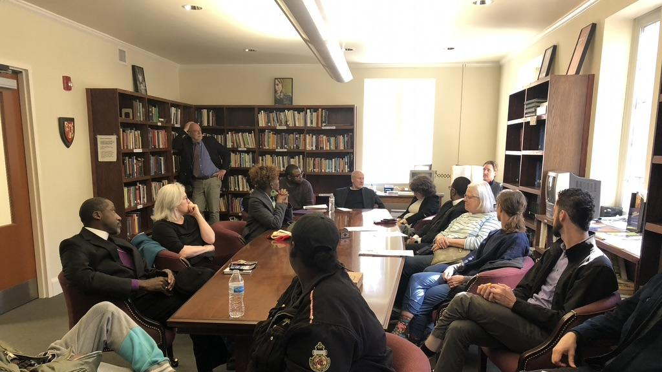
Core Team

Slide 8
What a Core Team Does
Internal Power Analysis
8-10 Individual Meetings over 3 months
Keep notes after each meeting
Meet with Pastor/Rabbi/Imam every 4-6 weeks
Recruitment & Action turnout
Metro Council

Slide 10
Internal Power Analysis
A RELATIONAL MAP OF YOUR INSTITUTION
Who are the Leaders and what following do they have?
How do these leaders relate to one another?
How are decisions made?
How does the congregation determine how money is used?
What are the key priorities of the institution based on money spent and energy?

Slide 11
Internal Power Analysis cont.
A RELATIONAL MAP OF YOUR INSTITUTION
What are key moments in the congregation/institution?
Usually tied to the priorities
How does the congregation/institution interact with the outside world/key partners?

Slide 13
Relational meetings are the building blocks for developing the relationships needed to strengthen our congregation and ministries. We do relational meetings in order to:
Purpose of Relational Meetings:

Slide 14
Spot leaders and identify people with talent/potential;
Discover people’s interests and identify issues they would be willing to act on;
Develop fruitful relationships with people whose interests could be met through serving on our ministry;
Find other people to do one on one meetings with.
Purpose of Relational Meetings:

